Slide 1

STO(001) Characterization and Literature Review
Literature Review:
Found the most widely available RHEED images for STO(001) in available literature
Reconstructions include:
(1 x 1)
(2 x 1)
(1 x 2)
c(4 x 4)
√13 x √13 R33.7°
√13 x √13 + c(6 x 2) (superposition of two reconstructions)
Literature is often difficult to get ideal images from, due to differing MBE set ups and parameters across different labs
The result is that sometimes we get lower quality images than we are hoping for.

Slide 2
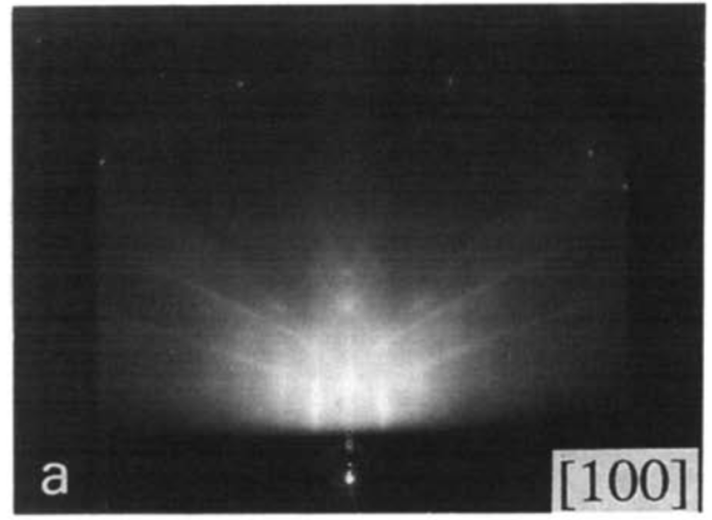
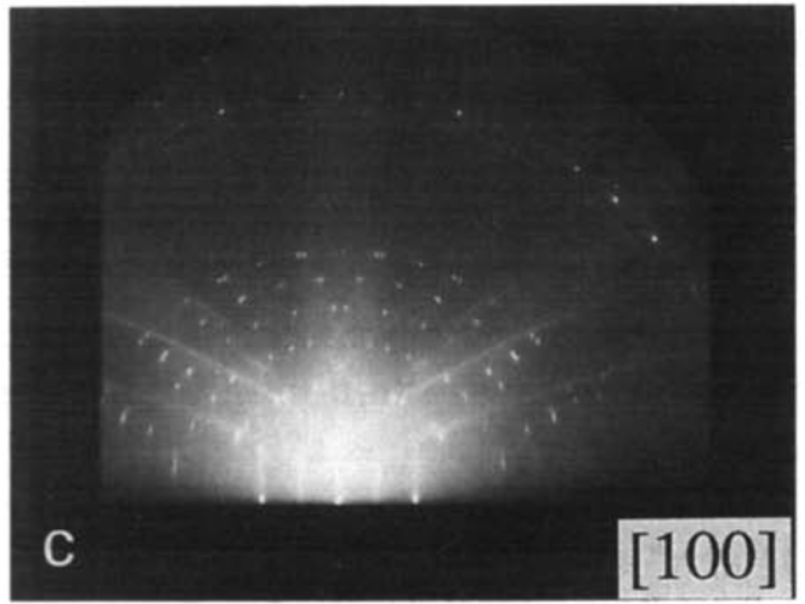
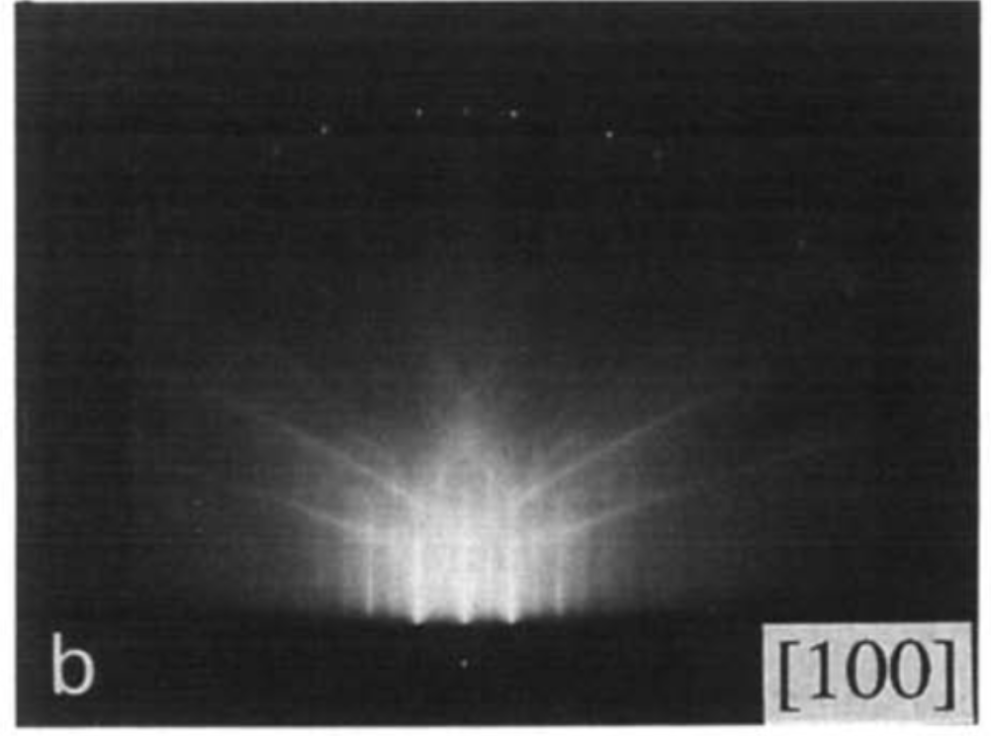
(1 x 1), (2 x 1), √13 x √13(-R33.7°) + c(6 x 2)
(1 x 1)
Twinned √13 x √13(-R33.7°) + c(6 x 2)
Fig. 2. RHEED patterns of the SrTiO3(001 ) surfaces given different surface treatments. (a) as-polished surface, (b) vacuum-annealed surtace, and (c) oxygen-annealed surface with the [ 100] and [ 110] beam incidences.
Twinned(2 x 1)
Naito, Michio & Sato, Hisashi. (1994). Reflection high-energy electron diffraction study on the SrTiO3 surface structure. Physica C-superconductivity and Its Applications - PHYSICA C. 229. 1-11. 10.1016/0921-4534(94)90805-2.
Notes:
This paper examines the RHEED images of different treatment types for STO along (001) and (110) crystal faces. Published in 1994, it is far from the most recent paper, but it also dives into the science of RHEED and the physical features that are reflected. Potentially useful for education purposes.

Slide 3
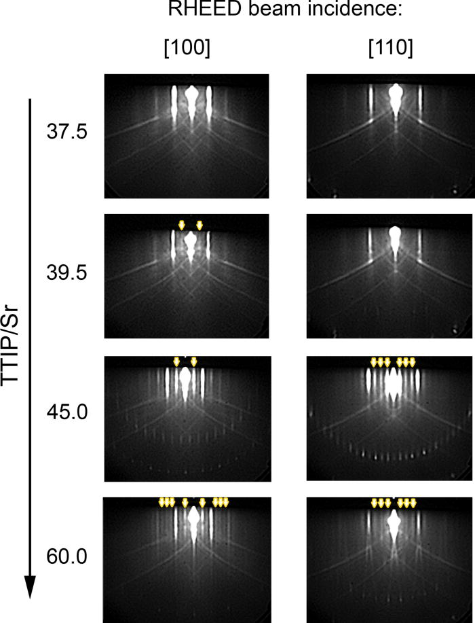
(1 x 1), (1 x 2), c(4 x 4)
c(4 x 4)
(1 x 1)
c(4 x 4)
(1 x 2)
From: Surface reconstructions in molecular beam epitaxy of SrTiO₃
Appl. Phys. Lett. 105, 191901 (2014)
Notes:
This paper captures the changing RHEED patterns and therefore surface reconstructions as a function of TTIP/Sr. The first image corresponds to 37.5, second to 39.5, third to 45.0, and last to 60.0. These were all at T = 810 C.

Slide 4
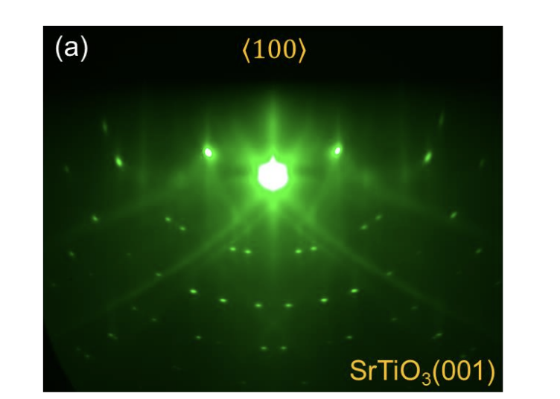
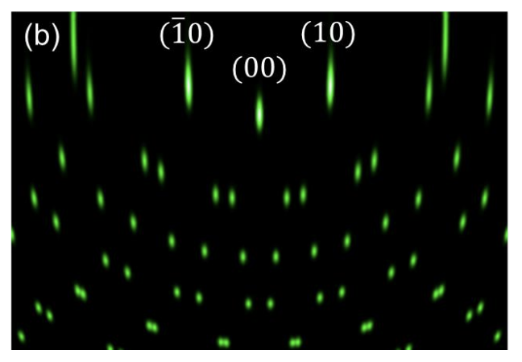
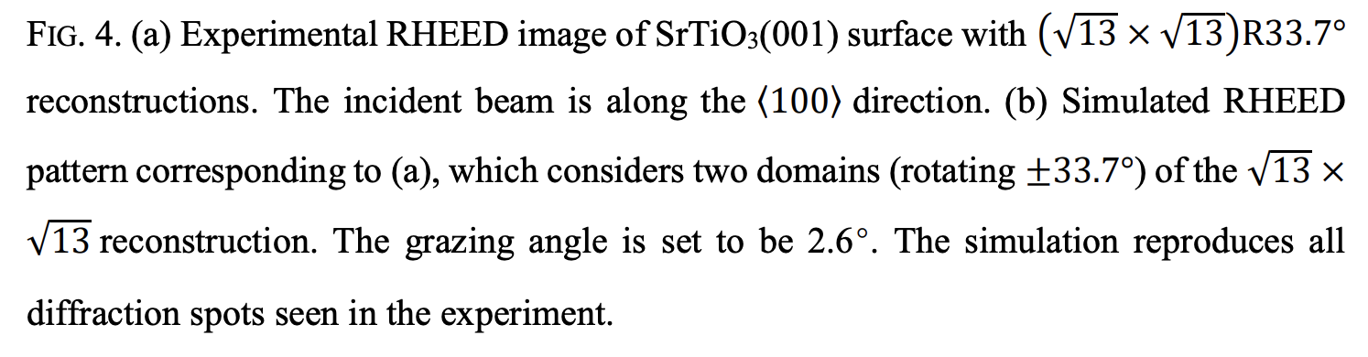
√13 x √13(-R33.7°)
(√13 x √13)R33.7°
Chong Liu, Kai Chang, Ke Zou; Realistic simulation of reflection high-energy electron diffraction patterns for two-dimensional lattices using Ewald construction. J. Vac. Sci. Technol. B 1 September 2022; 40 (5): 054002. https://doi.org/10.1116/6.0001899
Notes:
In this paper, the authors use kinematic theory and Ewald construction to simulate the geometric transformations and the corresponding RHEED patterns.

Slide 5
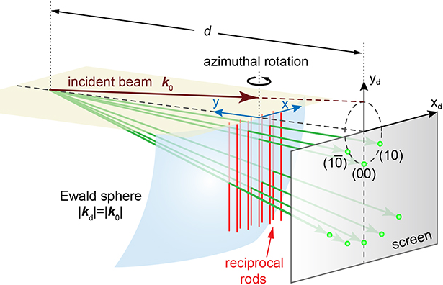
STO RHEED Simulation
In the paper Lui et al. J. Vac. Sci. Technol. B (2022), the authors introduced a software that uses RHEED kinematic theory to simulate realistic RHEED images
How it works:
Input real lattice unit cell
Real space geometry
Transform into reciprocal space: real points → reciprocal lattice rods
Use Ewald Sphere construction to calculate diffraction conditions
Project intersections of sphere with rods onto screen
Result: simulated RHEED pattern derived from theory
Chong Liu, Kai Chang, Ke Zou; Realistic simulation of reflection high-energy electron diffraction patterns for two-dimensional lattices using Ewald construction. J. Vac. Sci. Technol. B 1 September 2022; 40 (5): 054002. https://doi.org/10.1116/6.0001899

Slide 6
Simulation Parameters
STO(001) Reconstruction | (1 x1) | (2 x 1) | (2 x 1)/(1 x 2) | √13 x √13 (ideal) | √13 x √13 (from paper) | c(6 x 2) | √13 x √13 + c(6 x 2)
Number of Lattices | 1 | 1 | 2 | 2 | 2 | 1 | 3
Lattice base vectors: (x_1, y_1), (x_2, y_2) | (1,0), (0,1) | (2, 0), (0, 1) | (2,0), (0,1) | (2,3), (3,-2) | (2,3), (3,-2) | (6,0), (0, 2) | (2, 3), (3,-2)
 |  |  |  |  |  |  | (3,2), (2,-3)
 |  |  | (1,0), (0,2) | (3,2), (2,-3) | (3,2), (2,-3) |  | (6,0), (0,2)
Structure factors: (r_a, r_b, f) | (0, 0, 1) | (0, 0, 1) | (0,0,1) | (0,0,1) | (0,0,1) | (0, 0, 1) | (0, 0, 1)
 |  |  |  |  |  |  | (0, 0, 1)
 |  |  |  |  |  |  | (0, 0, 1) + (0.5, 0.5, 1)
Lattice Unit: (Å) | 3.905 | 3.905 | 3.905 | 3.905 | 3.905 | 3.905 | 3.905
Grazing Angle (°) | 3 | 3 | 3 | 3 | 2.6 | 3 | 3
Rotation (°) | 0 | 0 | 0 | 0 | 0 | 0 | 0
Beam E (keV) | 10 | 10 | 10 | 10 | 10 | 10 | 10
Broaden x, y | 1, 1 | 1, 1 | 1, 1 | 1, 1 | 0.8,0.7 | 1, 1 | 1, 1
Common Surface Reconstructions and their corresponding parameters in the software

Slide 7
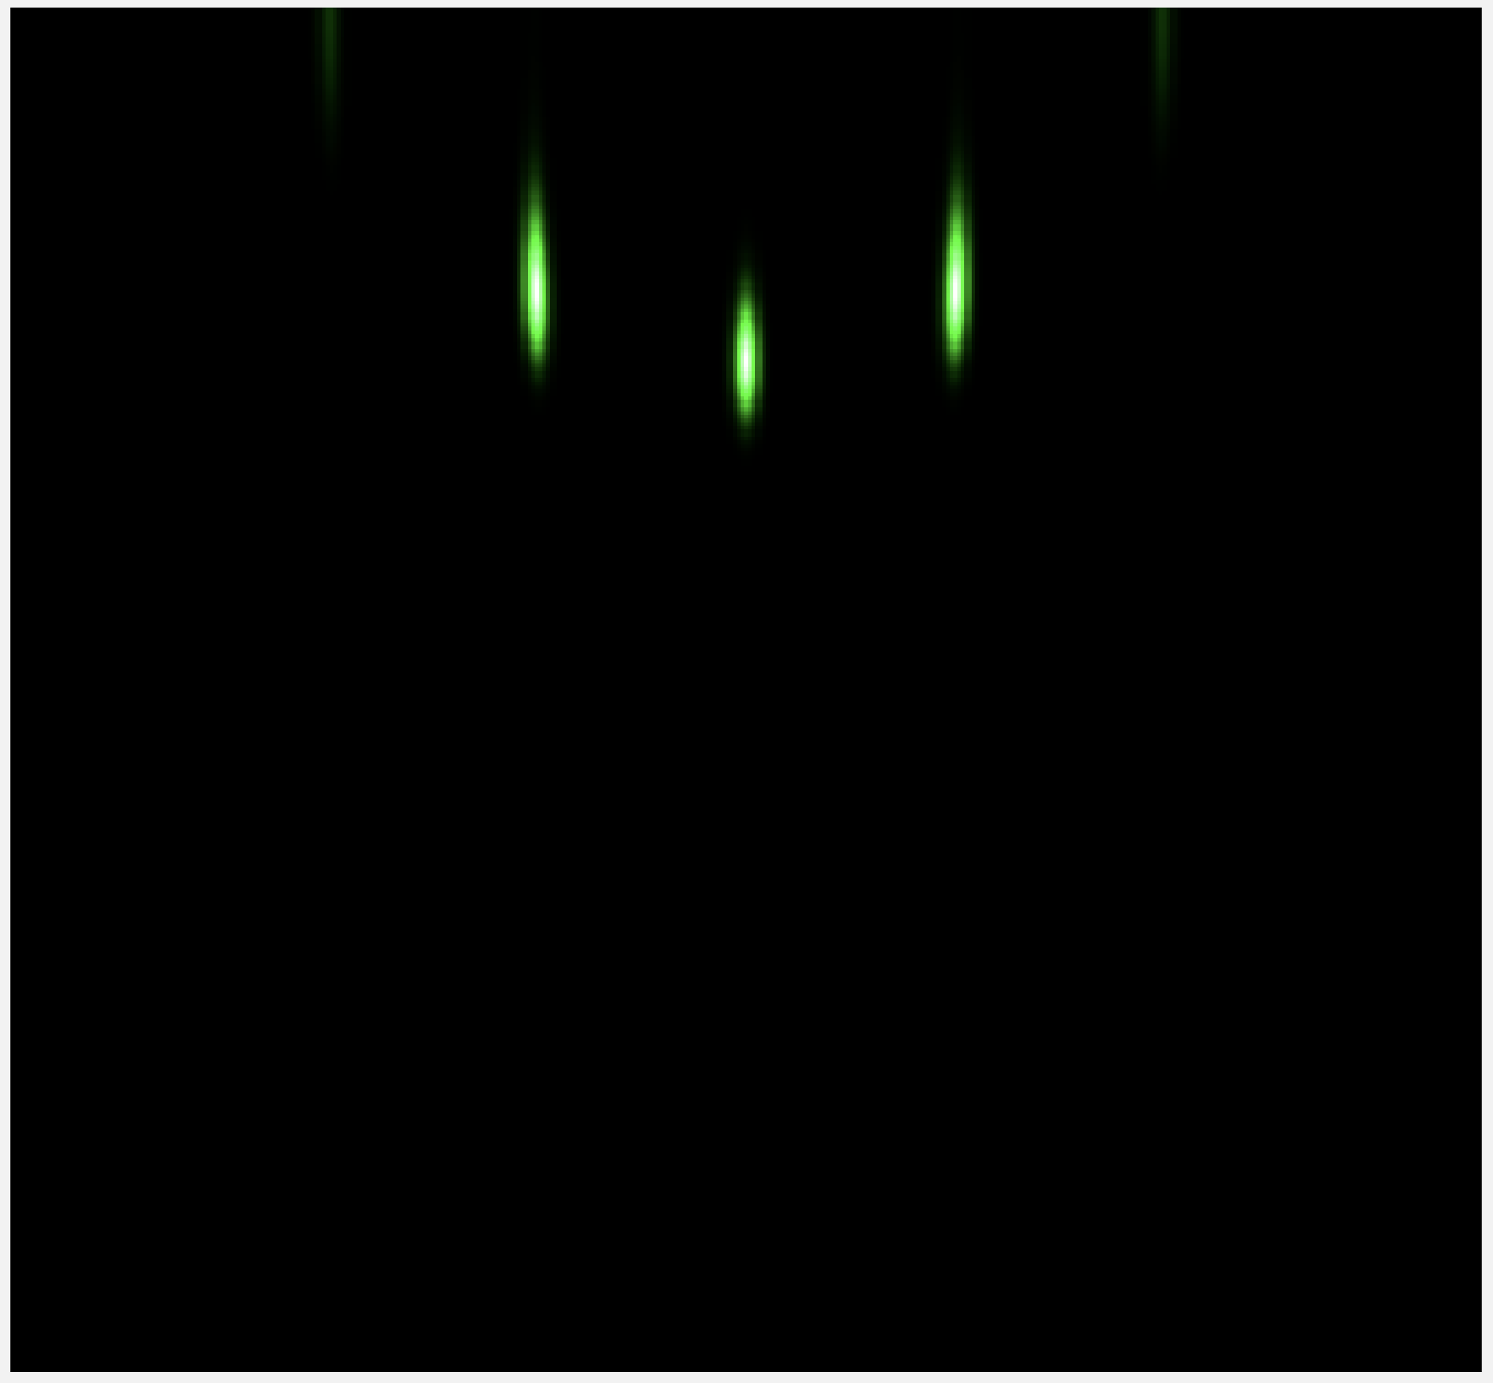
Simulated: (1 x 1) unreconstructed
STO(001) Reconstruction | (1 x1)
Number of Lattices | 1
Lattice base vectors: (x_1, y_1), (x_2, y_2) | (1,0), (0,1)
Structure factors: (r_a, r_b, f) | (0, 0, 1)
Lattice Unit: (Å) | 3.905
Grazing Angle (°) | 3
Rotation (°) | 0
Beam E (keV) | 10
Broaden x, y | 1, 1
Chong Liu, Kai Chang, Ke Zou; Realistic simulation of reflection high-energy electron diffraction patterns for two-dimensional lattices using Ewald construction. J. Vac. Sci. Technol. B 1 September 2022; 40 (5): 054002. https://doi.org/10.1116/6.0001899

Slide 8
Side by Side: (1 x 1) unreconstructed
Chong Liu, Kai Chang, Ke Zou; Realistic simulation of reflection high-energy electron diffraction patterns for two-dimensional lattices using Ewald construction. J. Vac. Sci. Technol. B 1 September 2022; 40 (5): 054002. https://doi.org/10.1116/6.0001899

Slide 9
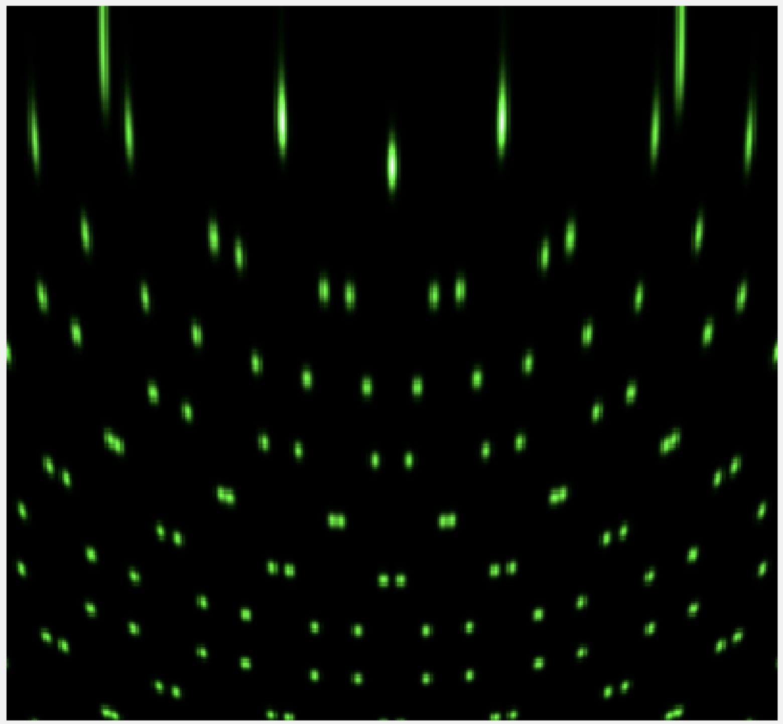
Simulated: √13 x √13(-R33.7°)
STO(001) Reconstruction | √13 x √13 (from paper)
Number of Lattices | 2
Lattice base vectors: (x_1, y_1), (x_2, y_2) | (2,3), (3,-2)
 | (3,2), (2,-3)
Structure factors: (r_a, r_b, f) | (0,0,1)
Lattice Unit: (Å) | 3.905
Grazing Angle (°) | 2.6
Rotation (°) | 0
Beam E (keV) | 10
Broaden x, y | 0.8,0.7
Chong Liu, Kai Chang, Ke Zou; Realistic simulation of reflection high-energy electron diffraction patterns for two-dimensional lattices using Ewald construction. J. Vac. Sci. Technol. B 1 September 2022; 40 (5): 054002. https://doi.org/10.1116/6.0001899

Slide 10
Side by Side: √13 x √13

Slide 11
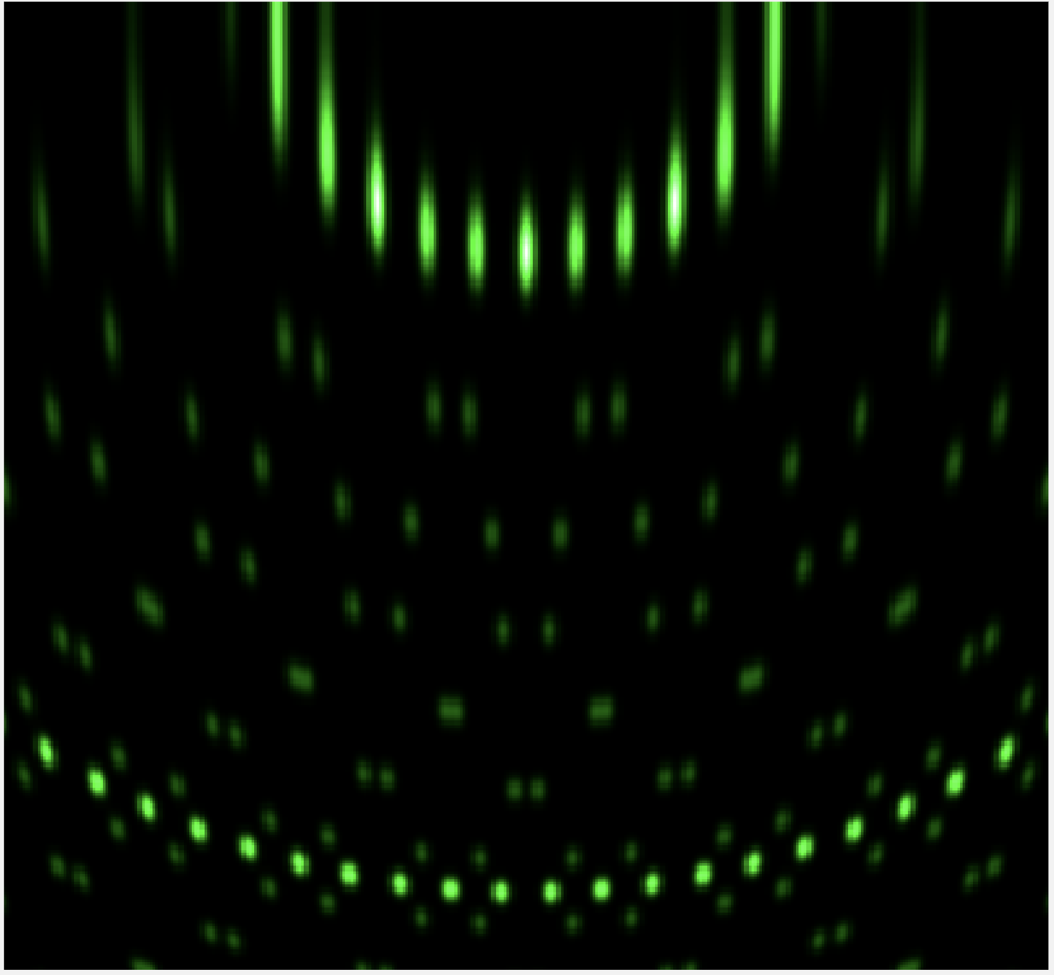
Simulated: √13 x √13(-R33.7°) + c(6 x 2)
STO(001) Reconstruction | √13 x √13 + c(6 x 2)
Number of Lattices | 3
Lattice base vectors: (x_1, y_1), (x_2, y_2) | (2, 3), (3,-2)
 | (3,2), (2,-3)
 | (6,0), (0,2)
Structure factors: (r_a, r_b, f) | (0, 0, 1)
 | (0, 0, 1)
 | (0, 0, 1) + (0.5, 0.5, 1)
Lattice Unit: (Å) | 3.905
Grazing Angle (°) | 3
Rotation (°) | 0
Beam E (keV) | 10
Broaden x, y | 1, 1
Chong Liu, Kai Chang, Ke Zou; Realistic simulation of reflection high-energy electron diffraction patterns for two-dimensional lattices using Ewald construction. J. Vac. Sci. Technol. B 1 September 2022; 40 (5): 054002. https://doi.org/10.1116/6.0001899

Slide 12
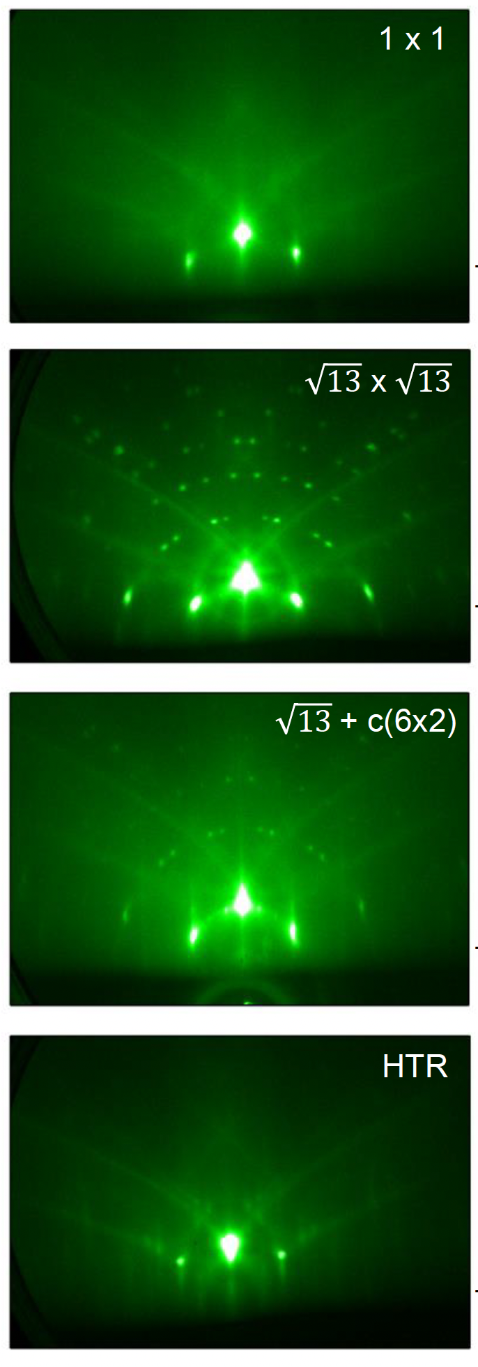
Side by Side: √13 x √13(-R33.7°) + c(6 x 2)
Chong Liu, Kai Chang, Ke Zou; Realistic simulation of reflection high-energy electron diffraction patterns for two-dimensional lattices using Ewald construction. J. Vac. Sci. Technol. B 1 September 2022; 40 (5): 054002. https://doi.org/10.1116/6.0001899

Slide 13
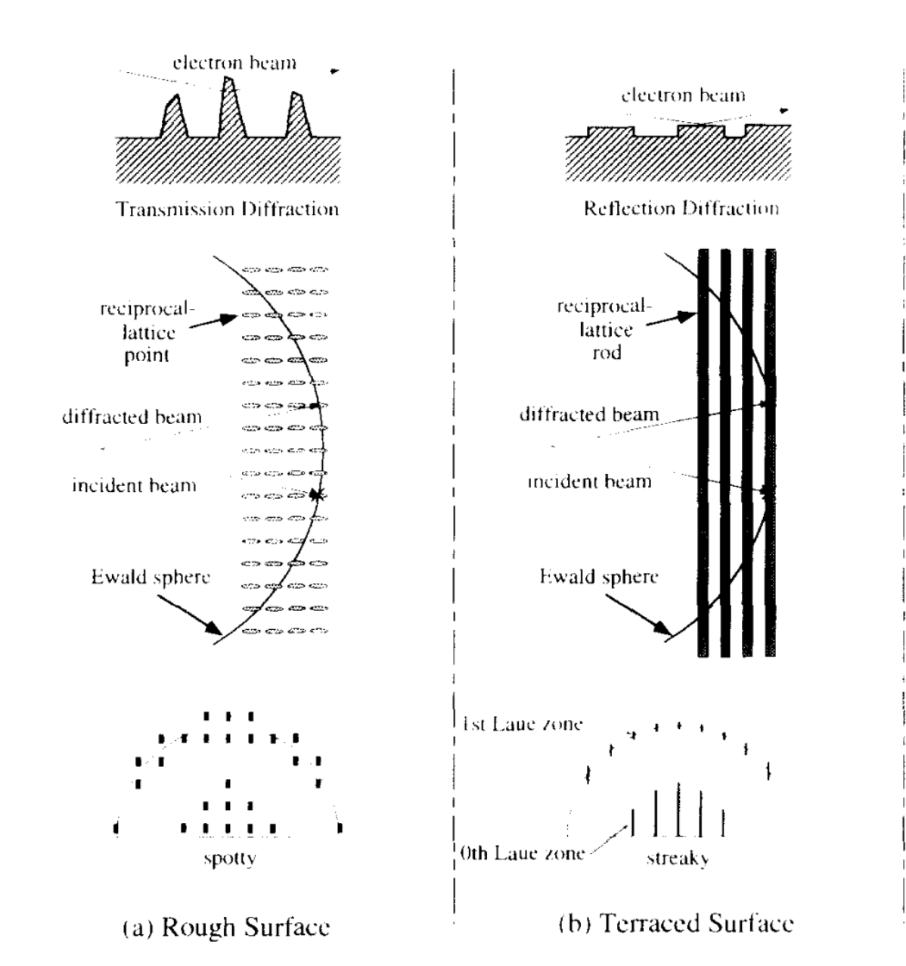
Simulation Caveats
Realistic Limitations of this software:
No Kikuchi lines
These come about from inelastic scattering, the simulation removes them
Idealized RHEED streaks
In experimental settings these streaks are often stretched due to various surface conditions
File format
These images are generated as .png’s, whereas the actual RHEED images are usually stored as .bmp’s
Parameter Uncertainty
Some of the parameters used in the software do not exactly correspond to the actual MBE set up in lab (ex. Grazing angle)
Not suitable replacement for real data
Helpful to have for what is ‘theoretically’ possible, but often does not resemble realistic RHEED images without having to tweak parameters
Naito, Michio & Sato, Hisashi. (1994). Reflection high-energy electron diffraction study on the SrTiO3 surface structure. Physica C-superconductivity and Its Applications - PHYSICA C. 229. 1-11. 10.1016/0921-4534(94)90805-2.

Slide 14
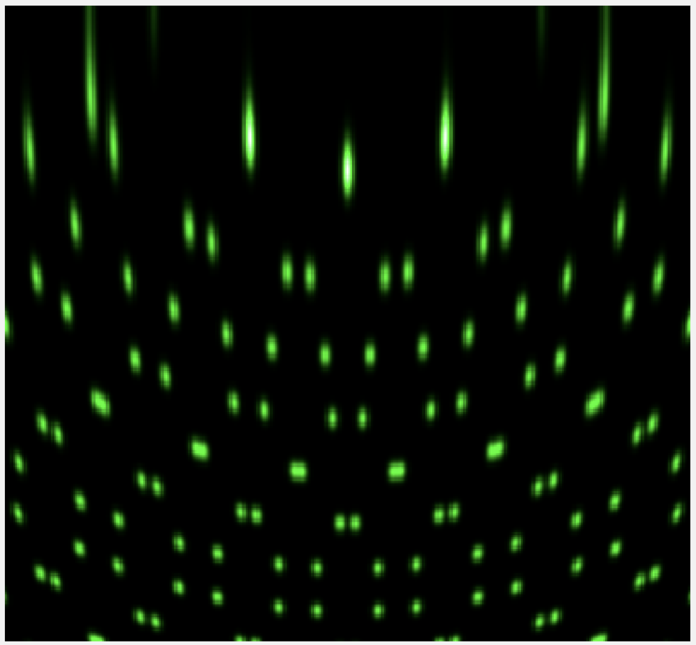
Subtask: STO characterization
√13 x √13(-R33.7°)
Our group
Ideal* simulation
Lui et al. Method
Lui et al. RHEED
Chong Liu, Kai Chang, Ke Zou; Realistic simulation of reflection high-energy electron diffraction patterns for two-dimensional lattices using Ewald construction. J. Vac. Sci. Technol. B 1 September 2022; 40 (5): 054002. https://doi.org/10.1116/6.0001899

Slide 15
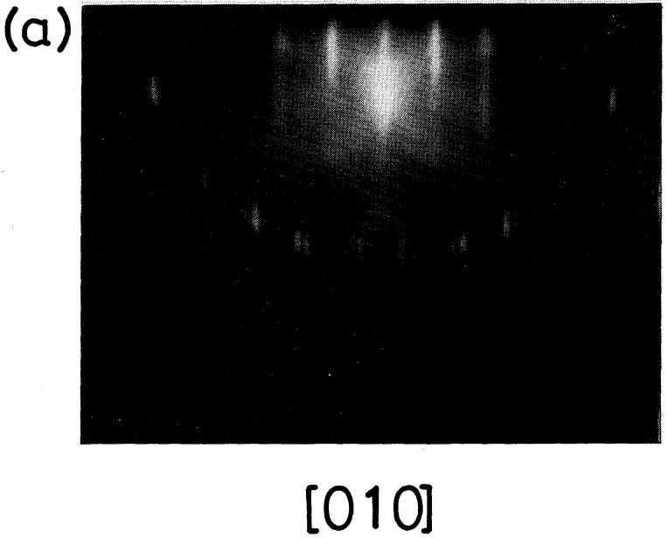
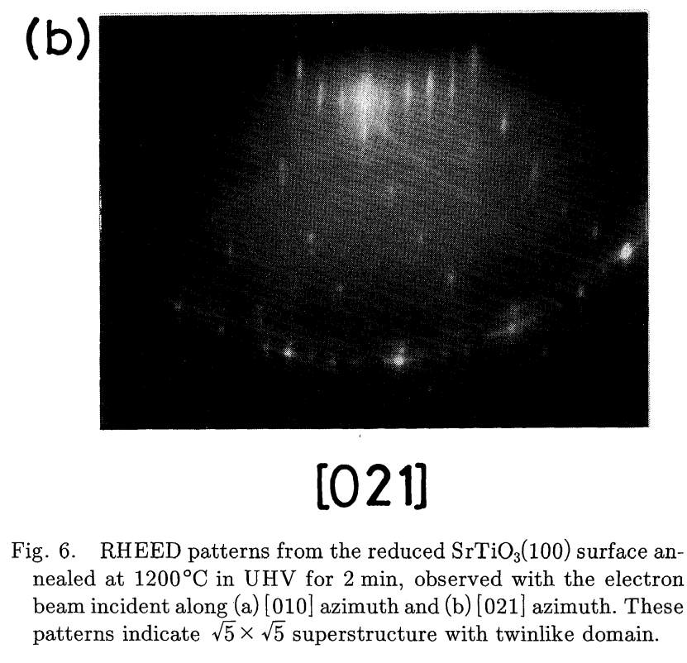
Subtask: STO characterization
√5 x √5-R26.6°
Hiroyuki Tanaka et al 1993 Jpn. J. Appl. Phys. 32 1405
Notes:
This paper was published in 1993. This image was taken at 1200 C in UHV for 2 minutes.

Slide 16
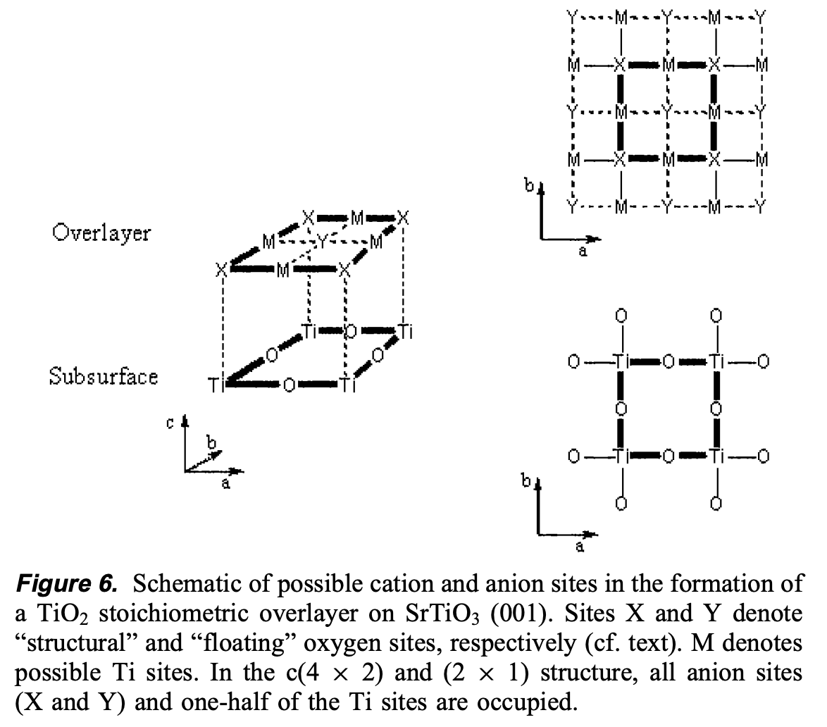
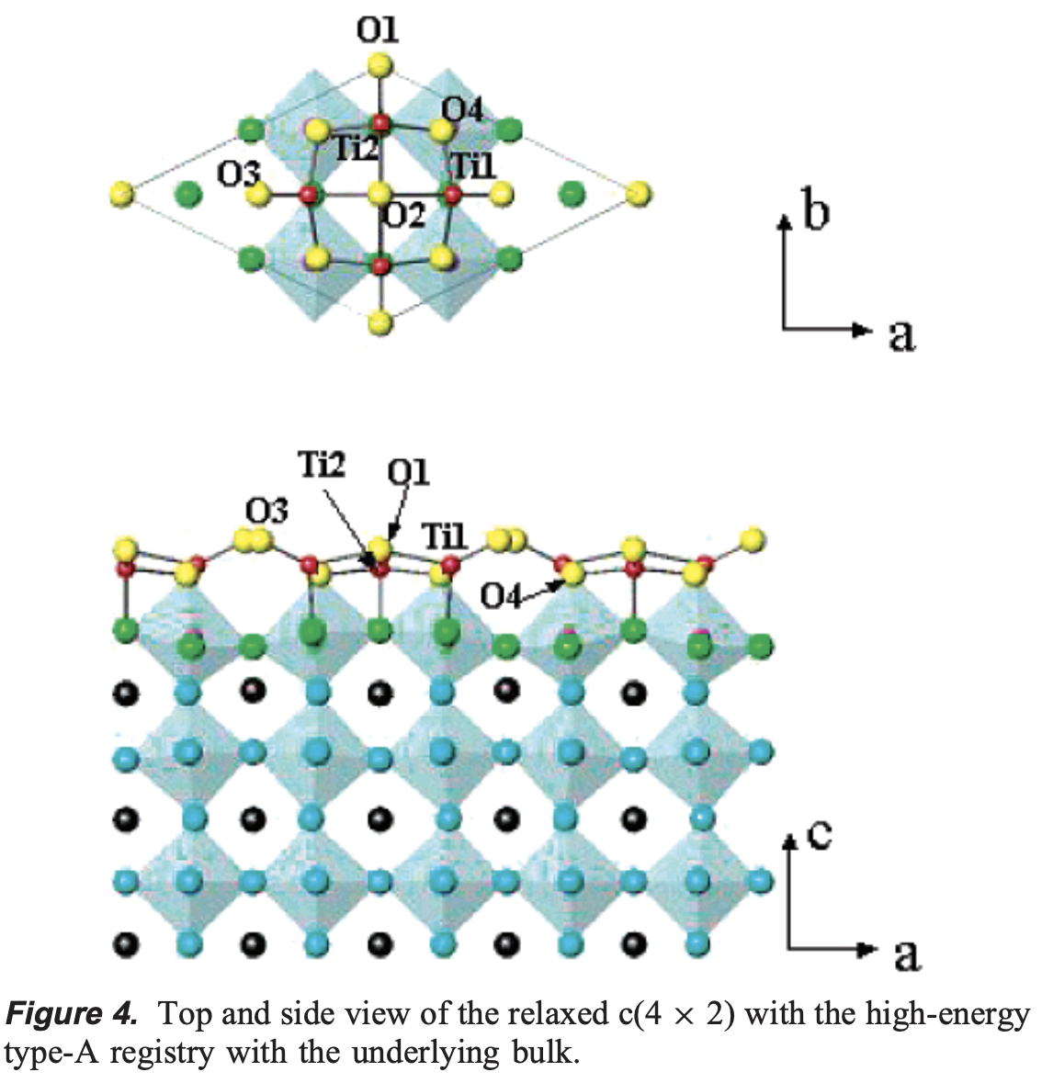
Subtask: STO characterization
Surface Structures of SrTiO₃ (001): A TiO₂-rich Reconstruction with a c(4 × 2) Unit Cell
Natasha Erdman, Oliver Warschkow, Mark Asta, Kenneth R. Poeppelmeier, Donald E. Ellis, and Laurence D. Marks
Journal of the American Chemical Society 2003 125 (33), 10050-10056
DOI: 10.1021/ja034933h
Notes:
I couldn’t find a RHEED image for c(4 x 2) reconstruction, but this paper from 2003 discusses the surface of STO in depth

Slide 17
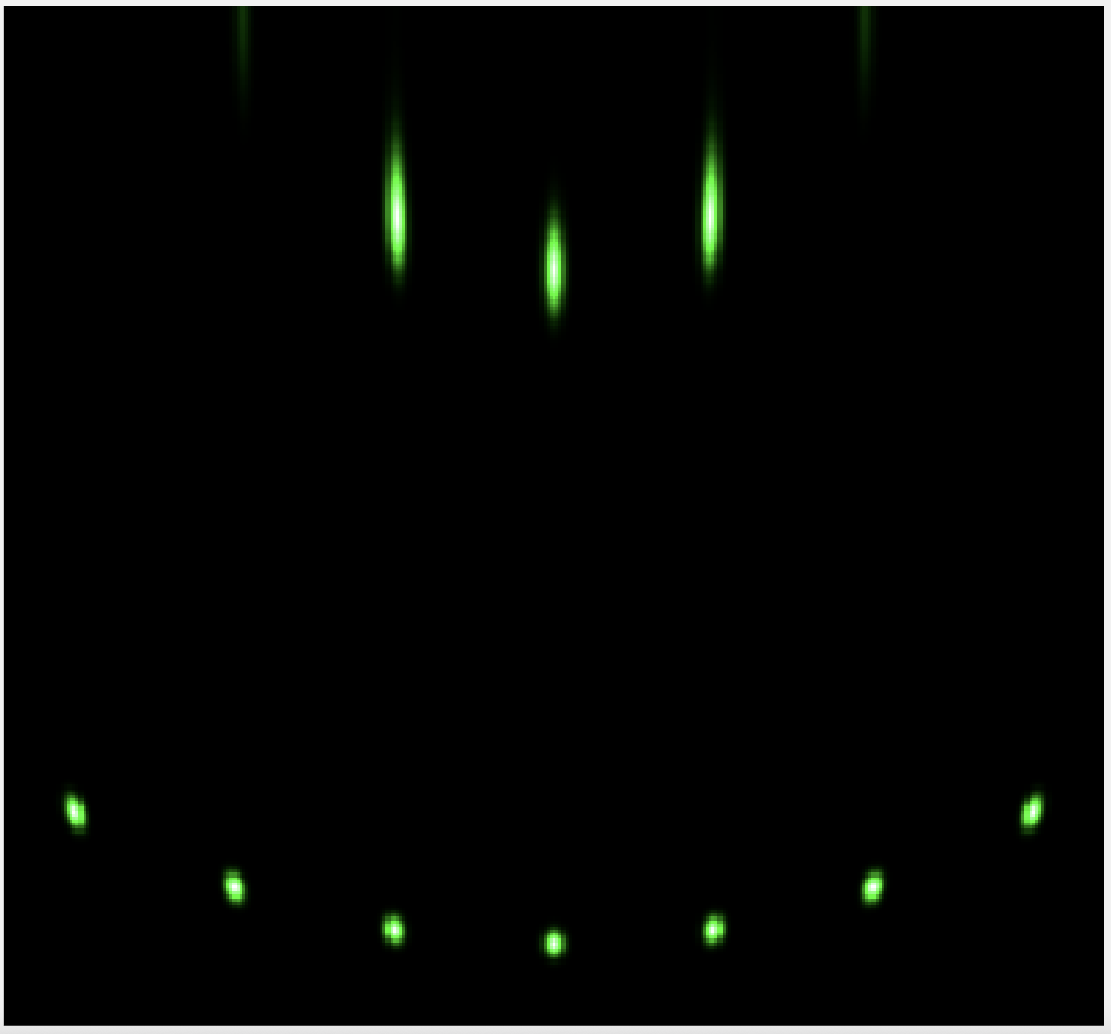
Subtask: STO characterization
(1 x 2) [100]
Chong Liu, Kai Chang, Ke Zou; Realistic simulation of reflection high-energy electron diffraction patterns for two-dimensional lattices using Ewald construction. J. Vac. Sci. Technol. B 1 September 2022; 40 (5): 054002. https://doi.org/10.1116/6.0001899
From: Surface reconstructions in molecular beam epitaxy of SrTiO₃
Appl. Phys. Lett. 105, 191901 (2014)

Slide 18
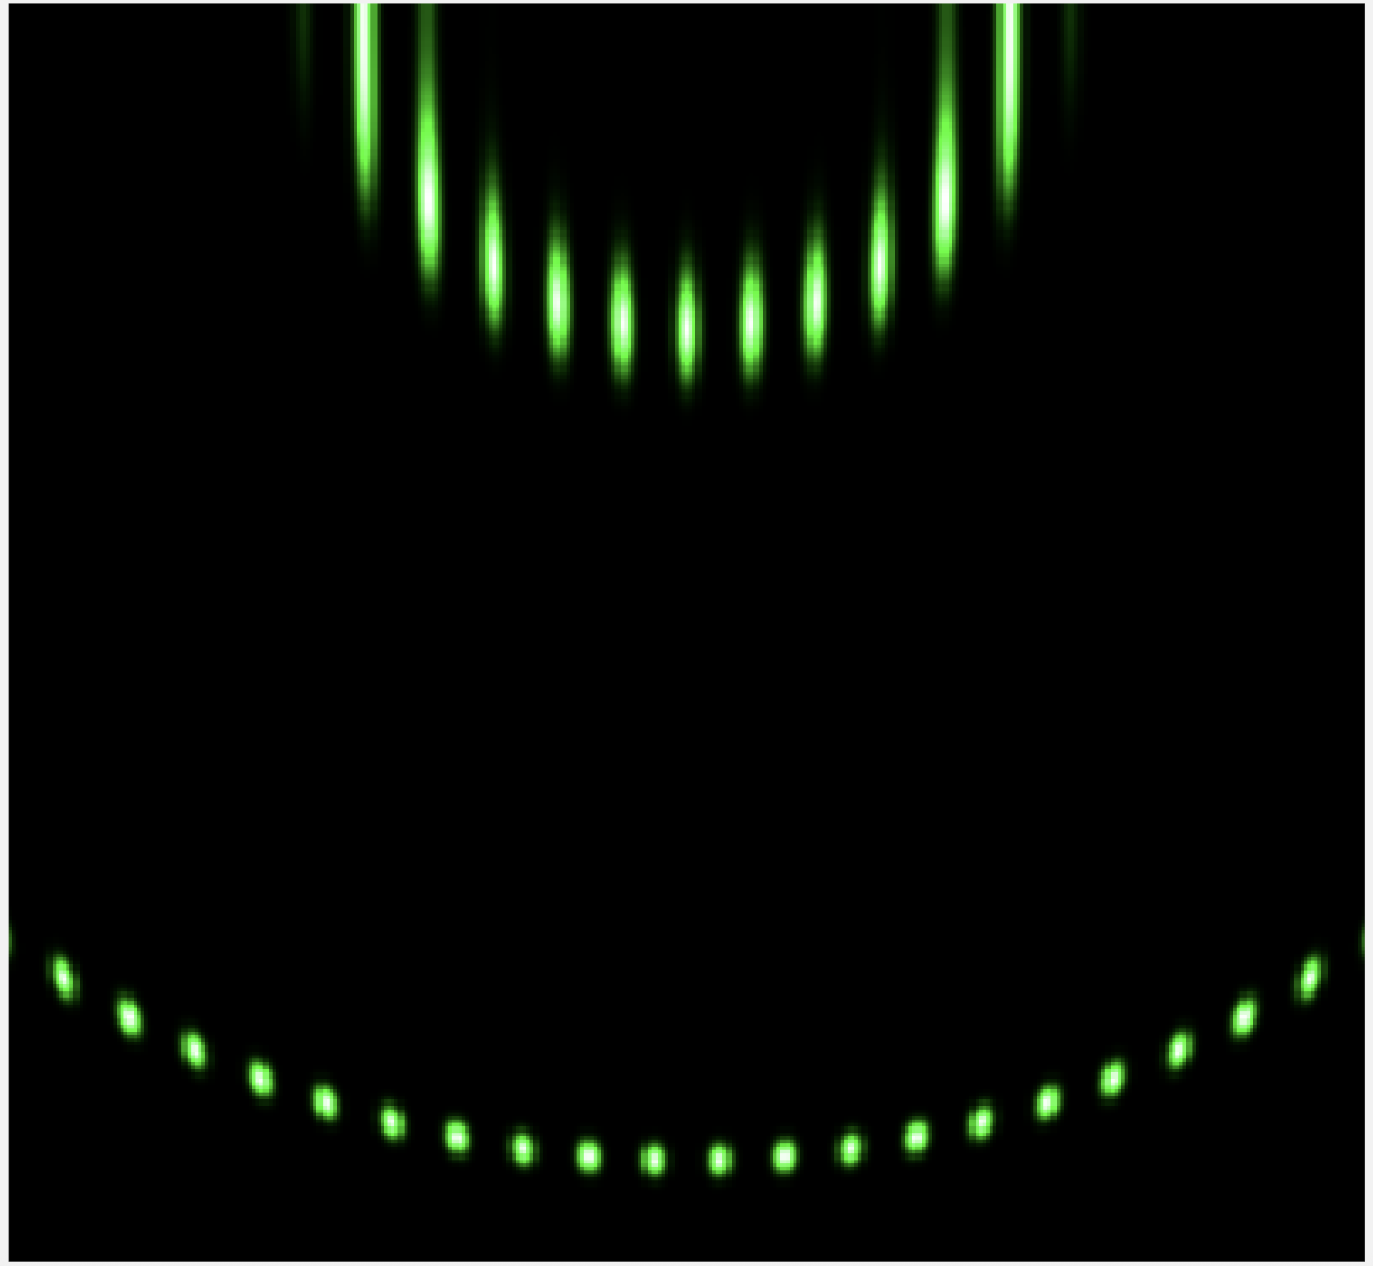
Subtask: STO characterization
c(6 x 2) (HTR)
Chong Liu, Kai Chang, Ke Zou; Realistic simulation of reflection high-energy electron diffraction patterns for two-dimensional lattices using Ewald construction. J. Vac. Sci. Technol. B 1 September 2022; 40 (5): 054002. https://doi.org/10.1116/6.0001899

Slide 19

Subtask: STO characterization
(2 x 1) [100]
Chong Liu, Kai Chang, Ke Zou; Realistic simulation of reflection high-energy electron diffraction patterns for two-dimensional lattices using Ewald construction. J. Vac. Sci. Technol. B 1 September 2022; 40 (5): 054002. https://doi.org/10.1116/6.0001899

Slide 20
Subtask: STO characterization
√13 x √13(-R33.7°)
Ideal* simulation
Lui et al. Method
Chong Liu, Kai Chang, Ke Zou; Realistic simulation of reflection high-energy electron diffraction patterns for two-dimensional lattices using Ewald construction. J. Vac. Sci. Technol. B 1 September 2022; 40 (5): 054002. https://doi.org/10.1116/6.0001899

